Slide 1



PROJECT ON
Hospital Patient Care Operations Analysis A DATABASE AND DATA ANALYTICS PROJECT USING MYSQL
Presented By
Prasanna Panchumarthi

Slide 2
Agenda
Objective of the Project
Database Structure
ER Diagram
Key Analysis Questions
Business Insights
Challenges / Experience
Conclusion

Slide 3
Objective of the Project
To design and implement a relational database for CarePlus Hospital using MySQL.
To manage and organize data related to patients, doctors, rooms, appointments, and treatments.
To maintain accurate relationships and data integrity using Primary Keys and Foreign Keys.
To analyze healthcare operations and identify important patterns using SQL queries.
To generate meaningful insights that support better operational decision-making in the hospital.

Slide 4
Database Structure
This project contains 5 interrelated tables:
Patients – Stores patient details and demographic information.
Doctors – Stores doctor information and professional details.
Rooms – Stores room types and equipment information.
Appointments – Stores patient appointment and booking details.
Treatments – Stores treatment records, outcomes, duration, and waiting time.
Data Relationships
The tables are connected using Primary Keys and Foreign Keys to maintain data integrity and establish proper relationships between the healthcare entities.

Slide 5
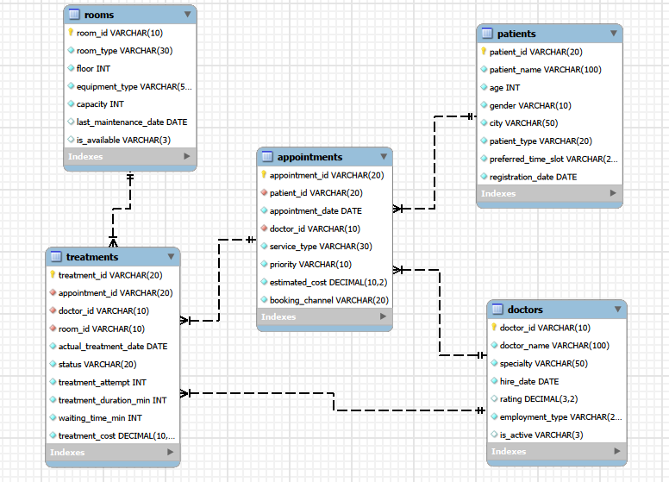
ER Diagram

Slide 6




Key Analysis Questions
What is the total number of patients?
Query :
Output :
Counts all the patient records available in the hospital database.
What is the total number of appointments?
Query :
Output :
Counts the total appointments recorded in the database.

Slide 7



What is the total estimated appointment value?
Query :
Output :
The combined estimated appointment value is approximately 14.33 million..
What is the average treatment duration?
Query :
Output :
Calculates the average treatment duration is approximately 38.72 minutes

Slide 8

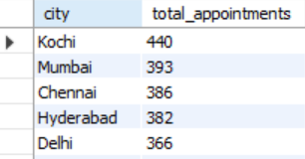
Patient and Appointment Demand
Which cities have the highest appointment volume?
Query :
Output :
Kochi has the highest appointment demand, so hospital management may need to pay particular attention to capacity and scheduling for this location.

Slide 9

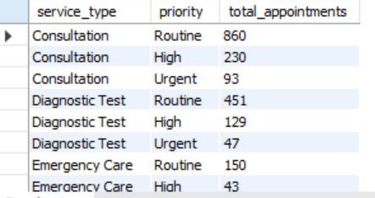
Comparing appointments across Service types and Priorities ?
Query :
Output :
This helps management understand not just which service is popular, but also the priority level associated with that service.

Slide 10
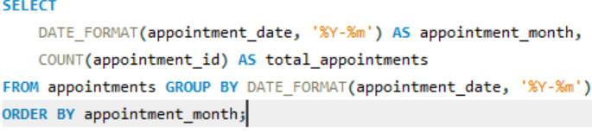
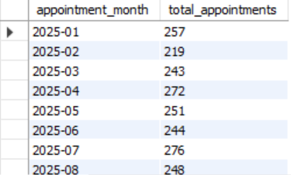
How does appointment volume change over time?
Query :
Output :
Appointment demand fluctuates from month to month, so hospital resources should be planned according to demand patterns rather than assuming constant demand.

Slide 11
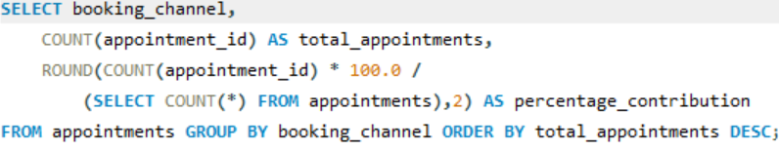
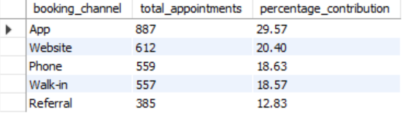
Which booking channels contribute most to appointment demand?
Query :
Output :
The inner SELECT calculates the total number of appointments, and the outer query uses that value to calculate each booking channel's percentage contribution.
The slide's displayed percentage values are intended to show each channel's contribution to overall appointment demand.

Slide 12
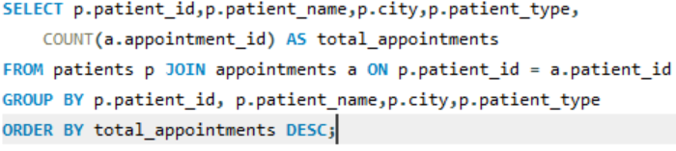
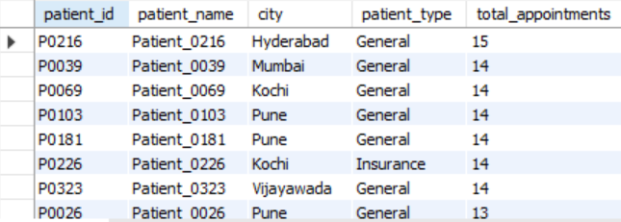
Patient and Appointment Behaviour
Which patients have the highest number of appointments?
Query :
Output :
This identifies high-frequency patients. These patients may require more frequent care or follow-up

Slide 13
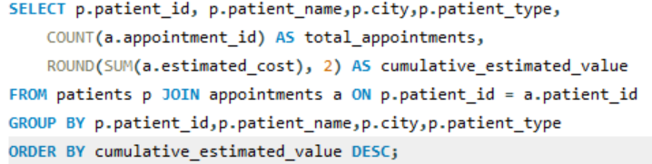
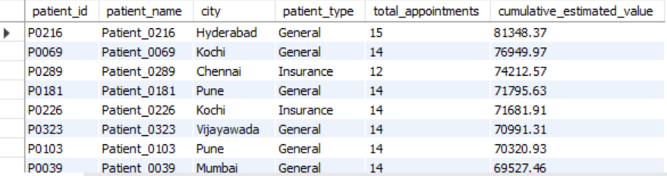
Which patients have the highest cumulative estimated appointment value?
Query :
Output :
Calculates the total estimated appointment value for each patient and identifies the highest-value patients.

Slide 14
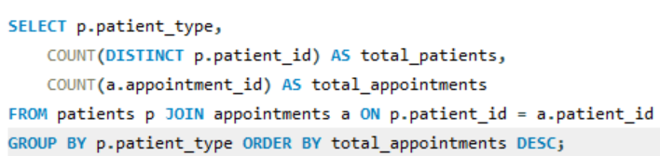
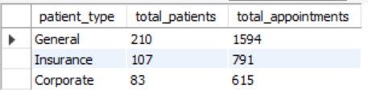
How do General, Corporate, and Insurance patients differ?
Query :
Output :
General patients represent the highest patient and appointment volume in this dataset.

Slide 15
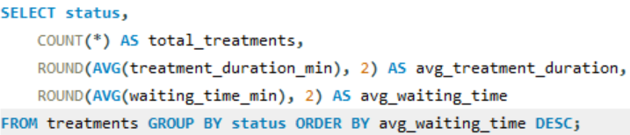
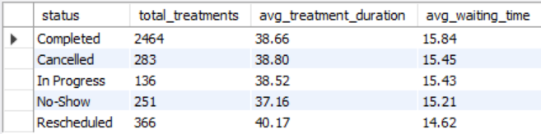
Treatment Performance
How do treatment duration and waiting time vary by status?
Query :
Output :
Calculates average treatment duration and waiting time for each treatment status.

Slide 16
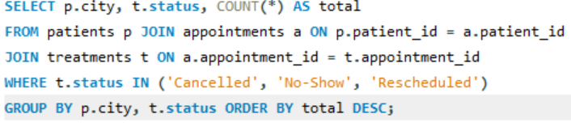
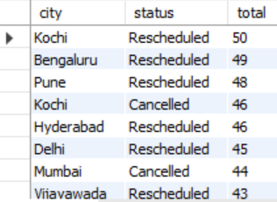
Which cities have the highest rate of problematic outcomes?
Query :
Output :
Identifies cities with higher numbers of cancellations, no-shows, and rescheduled treatments.

Slide 17
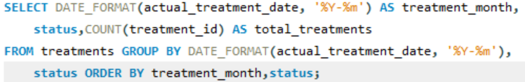
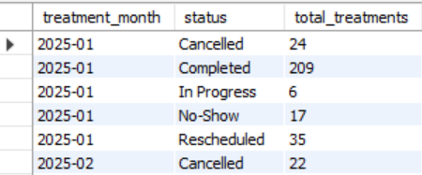
How does treatment performance change over time?
Query :
Output :
Tracks treatment outcomes by month to identify performance trends over time.

Slide 18
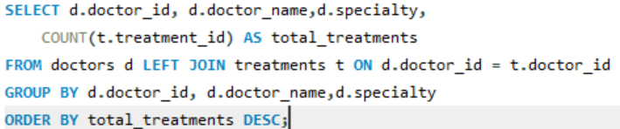
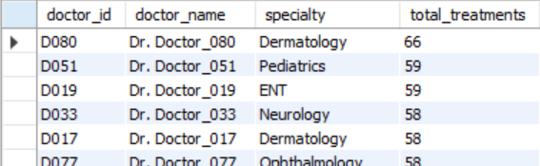
Doctor and Room Performance
Which doctors handled the highest number of treatments?
Query :
Output :
Counts treatments handled by each doctor to compare their workloads.

Slide 19
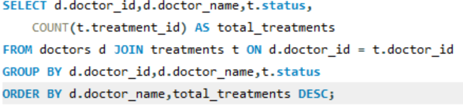
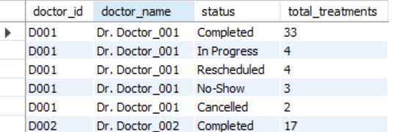
How does doctor performance differ across treatment outcomes?
Query :
Output :
Compares the treatment outcomes handled by each doctor.

Slide 20

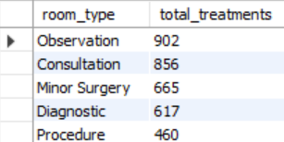
Which room types are used most frequently?
Query :
Output :
Observation rooms have the highest treatment usage in the displayed results, followed by consultation rooms.

Slide 21

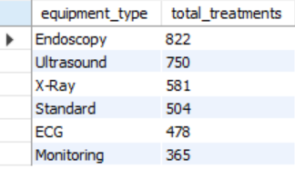
How is equipment utilized?
Query :
Output :
The hospital can identify which equipment categories are used most frequently, which can support maintenance, scheduling and resource allocation

Slide 22

Treatments and Appointment Problems
How many appointments required multiple treatment attempts?
Query :
Output :
The presentation reports that 500 appointments required multiple treatment attempts.

Slide 23
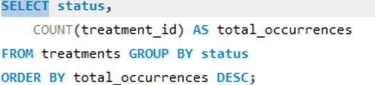
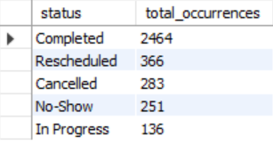
Which treatment statuses occur most frequently?
Query :
Output :
The presentation reports that 500 appointments required multiple treatment attempts.

Slide 24
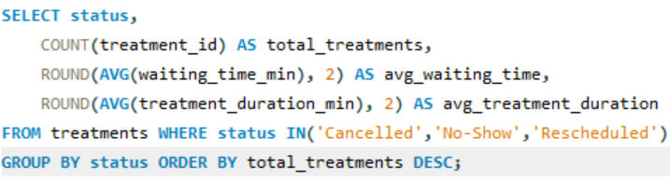
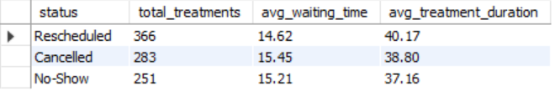
What patterns exist among problematic treatment statuses?
Query :
Output :
Rescheduled treatments are the most frequent problematic category in the displayed results, while cancelled treatments show the highest average waiting time among these three categories

Slide 25
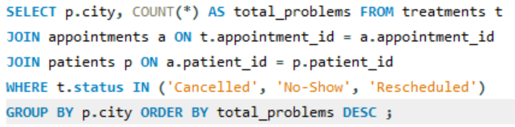
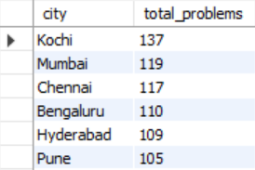
Which cities have the highest number of treatment problems?
Query :
Output :
Kochi has the highest number of problematic treatment records in the displayed output, so it may deserve additional operational investigation.

Slide 26
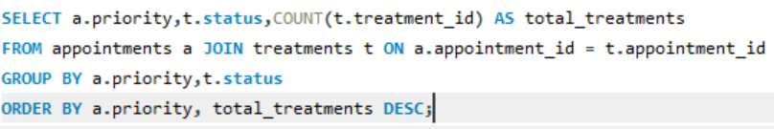
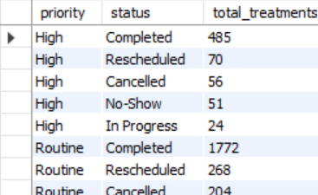
Is appointment priority associated with treatment outcomes?
Query :
Output :
Compares treatment outcomes across different appointment priority levels.

Slide 27
Key Findings
Kochi recorded the highest appointment volume.
Appointment demand varied across services, priorities, and months.
General patients generated the highest patient and appointment volume.
Completed treatments were the most common treatment outcome.
Doctor workload and room utilization varied significantly.
500 appointments required multiple treatment attempts.

Slide 28
Business Insights
Improve scheduling processes to reduce rescheduling and appointment disruptions.
Focus operational resources on cities with higher appointment demand and treatment problems.
Patients with many appointments may require closer management.
Optimize doctor workloads - If certain doctors have significantly higher treatment counts, management can investigate workload distribution.
Improve room allocation and equipments
Strengthen management of cancellations, no-shows, and multiple treatment attempts.
Analyze priority-based treatment outcomes to improve operational planning.

Slide 29
Challenges/Experience
Designing proper relationships between the five tables using Primary Keys and Foreign Keys.
Importing and validating CSV data while maintaining data integrity and avoiding missing records.
Through this project, I improved my understanding of SQL JOINs, GROUP BY, aggregate functions, subqueries, date functions, and analytical thinking.
Conclusion
Successfully designed and implemented a relational database for CarePlus Hospital using MySQL.
Analyzed appointments, patient behaviour, treatment performance, doctor workload, and operational problems using SQL.
The analysis helped identify important patterns such as high appointment demand in specific cities, differences in resource utilization, treatment outcomes, and multiple treatment attempts.

Slide 30


